Slide 1


HEP NTUA Weekly Report 10/2/2021
George Bakas

Slide 2

Summary
TTbar analysis:
Created pipeline to switch to UL files
2016 is divided into preVFP and post VFP
We handle the samples as individual measurements
MC Production (Signal + QCD + Subdominant)
Training with new files
Update the existing files with new top Tagger output
Data production with new TopTagger
ToDo:
Re-do the whole pipeline of the analysis
Efficiency, Acceptance, Responses
Mass Fit, Ryield, Contamination, Closure Tests
Signal Extraction
Unfolding
------------------------
Systematics
------------------------
Combination

Slide 3
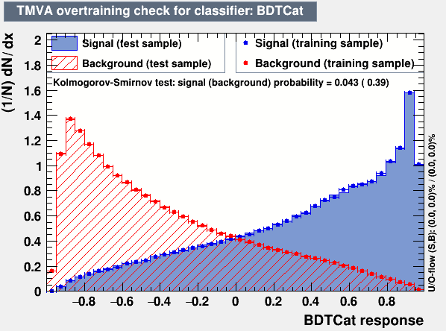

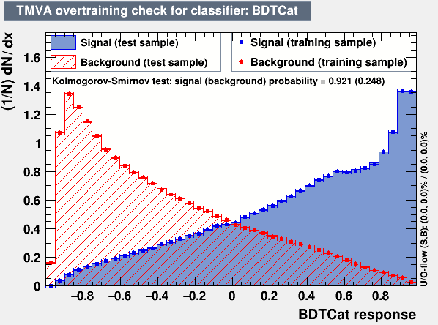
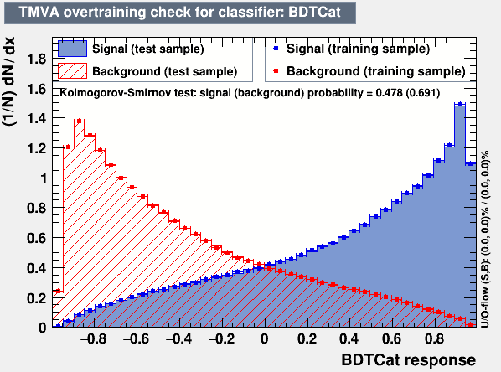
Training Output 2016 preVFP and postVFP, 2017 and 2018
2016 preVFP
2017
2016 postVFP
2018

